Slide 1
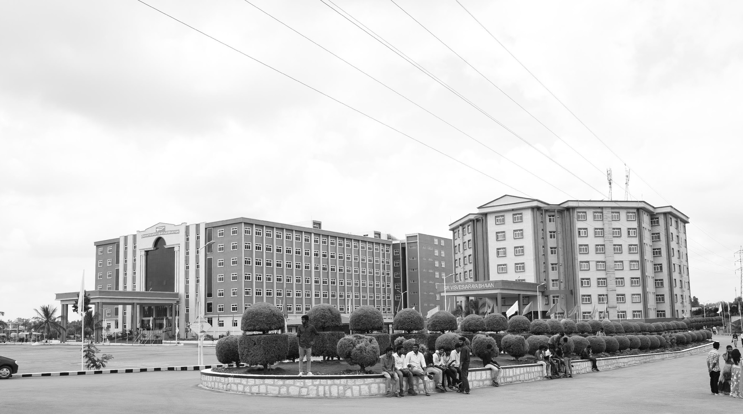

IMPLEMENTATION OF SMART BRIDGE USING IOT
AY 2021-25
GITAM UNIVERSITY
Project ID:
A University should be a place of light, of liberty, and of learning.
Department of Electrical Electronics and Communication Engineering
Project Team:
K BALAJI
T PRAVEEN KUMAR
J YUGANDHAR REDDY
Project Mentor:
DR. AJITH KUMAR
www.gitamedu.com

Slide 2

Project Group – Details
Photo
Track
Roll No
Name
Photo
EECE
BU21EECE0100451
K BALAJI
Photo
EECE
BU21EECE0100453
T PRAVEEN KUMAR
Photo
EECE
BU21EECE0100418
J YUGANDHAR REDDY

Slide 3


Slide 4


Slide 5


Slide 6
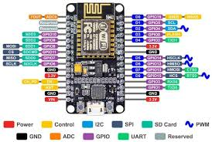
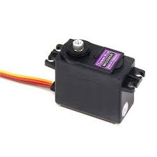
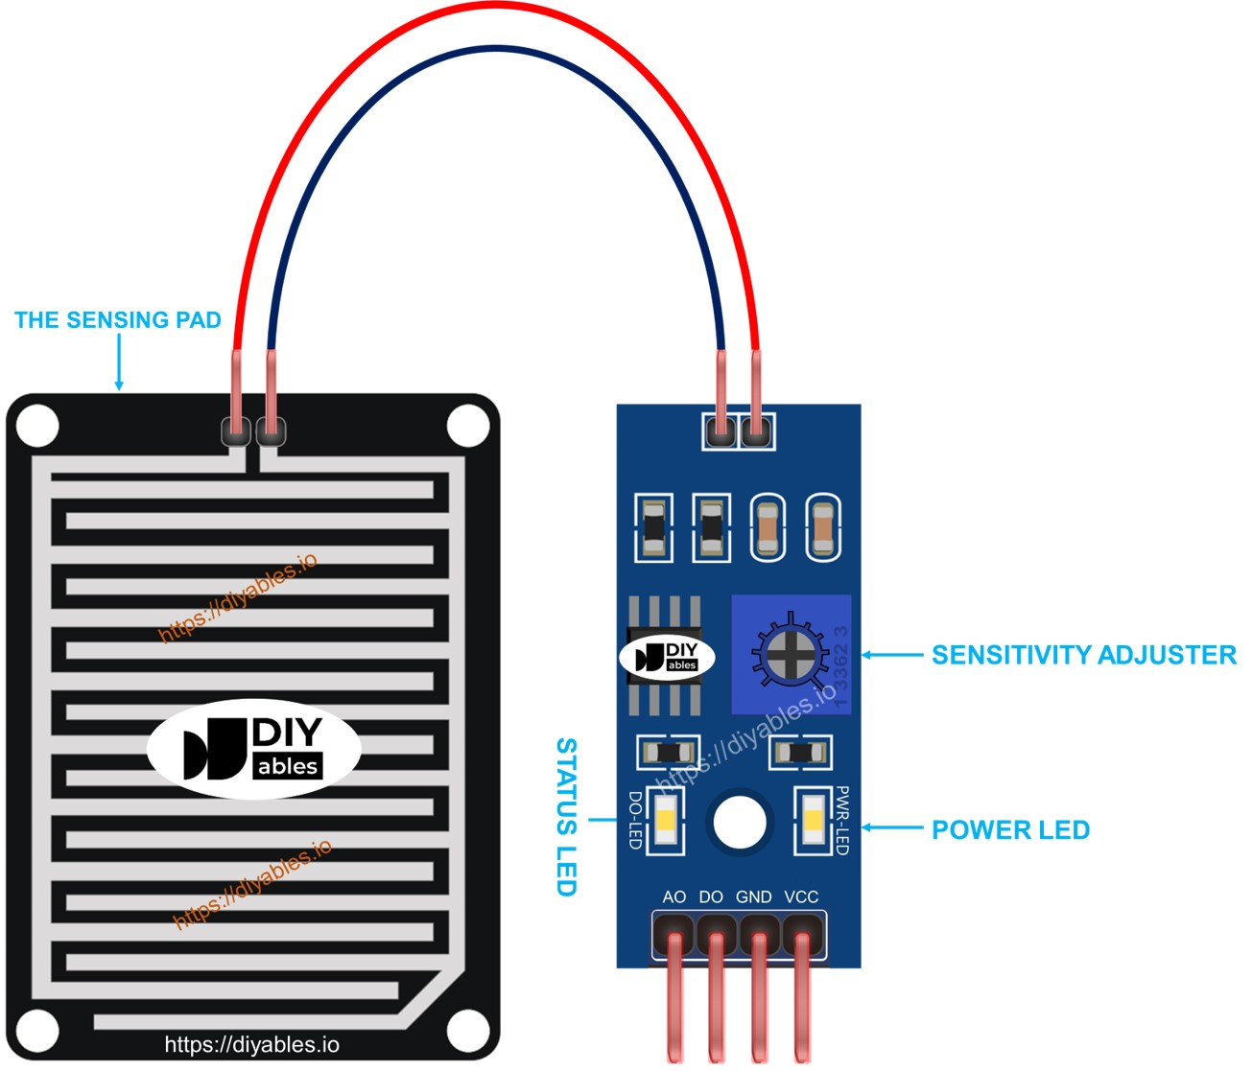
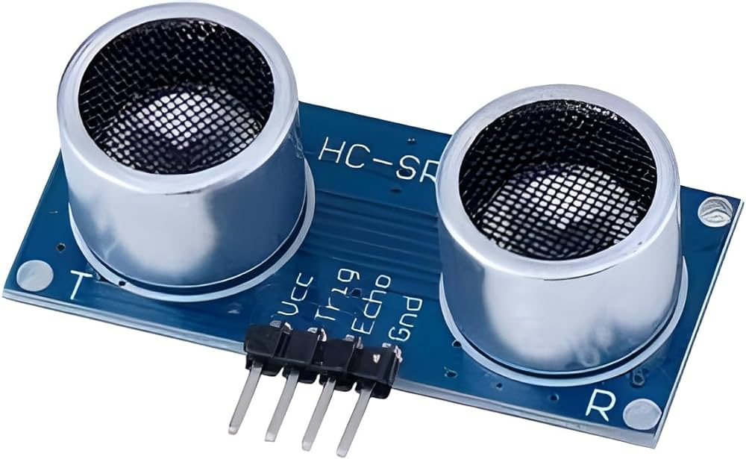
Equipment used
Esp8266 nodemcu
Servo motor
Ultrasonic sensor
Water sensor

Slide 7
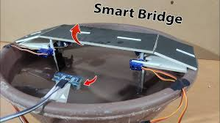

Slide 8
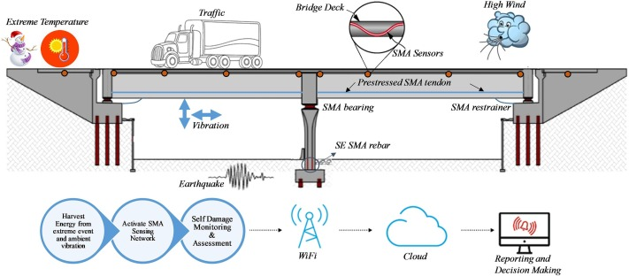

Slide 9
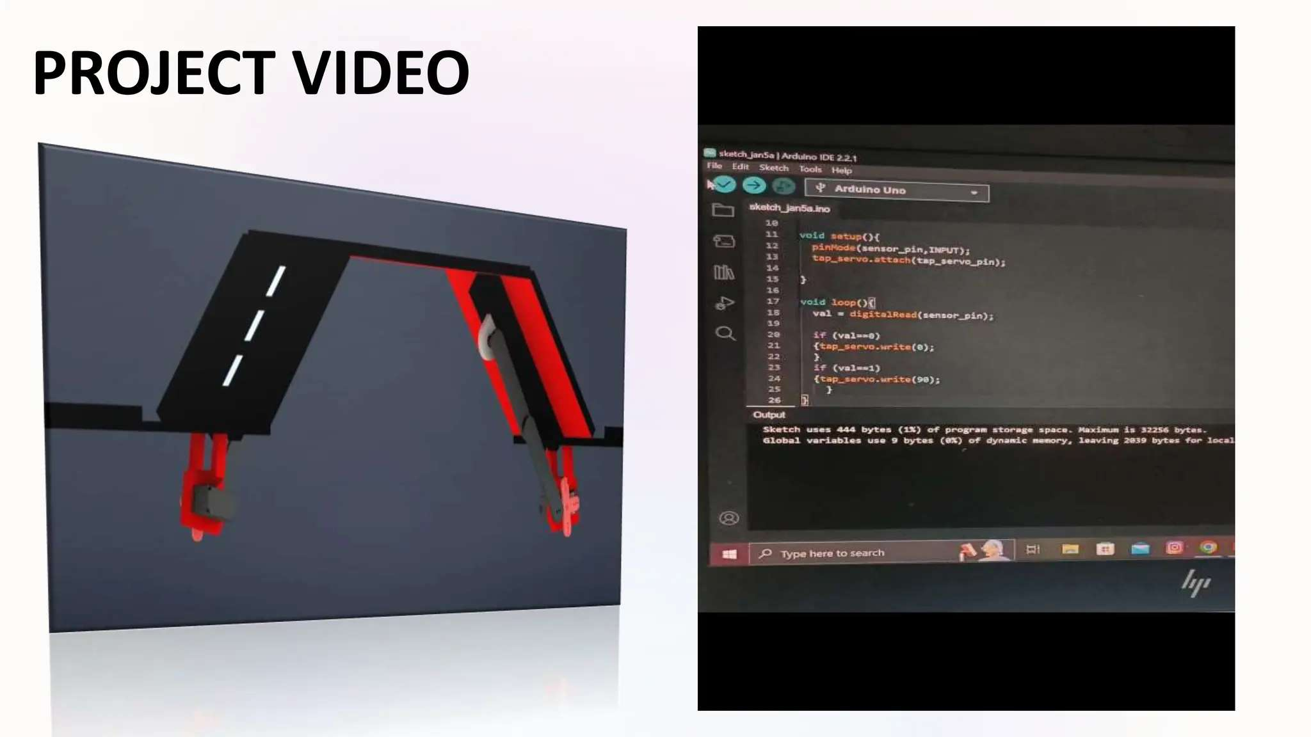

Slide 10


Slide 11
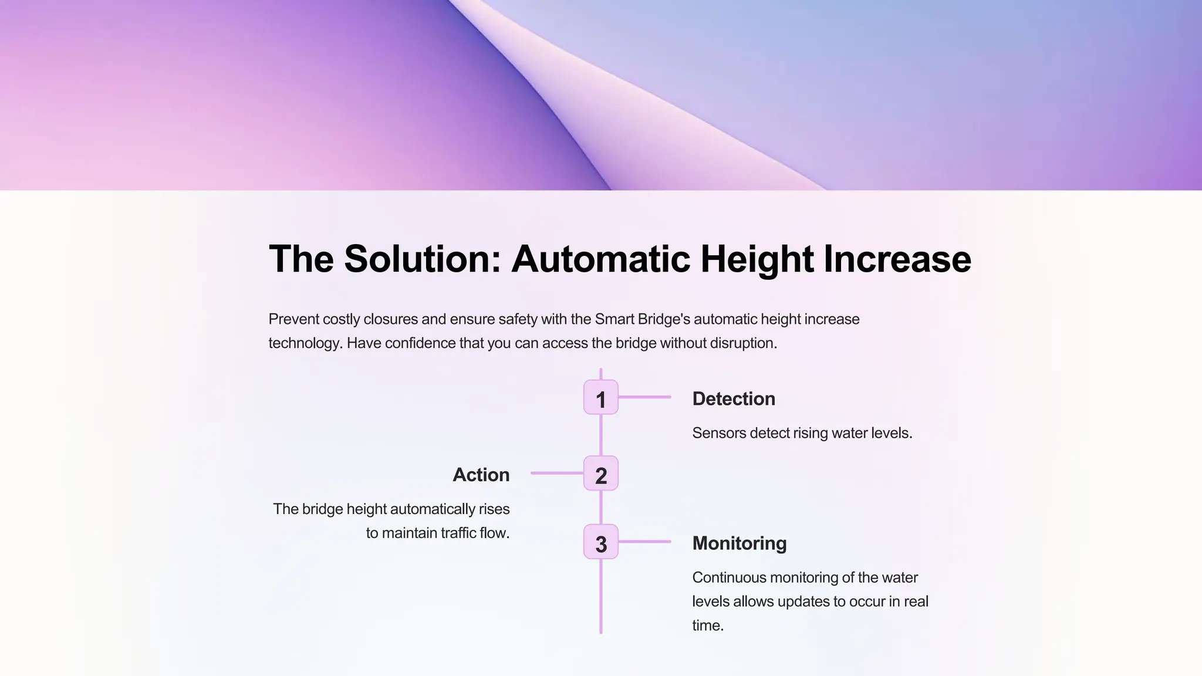

Slide 12
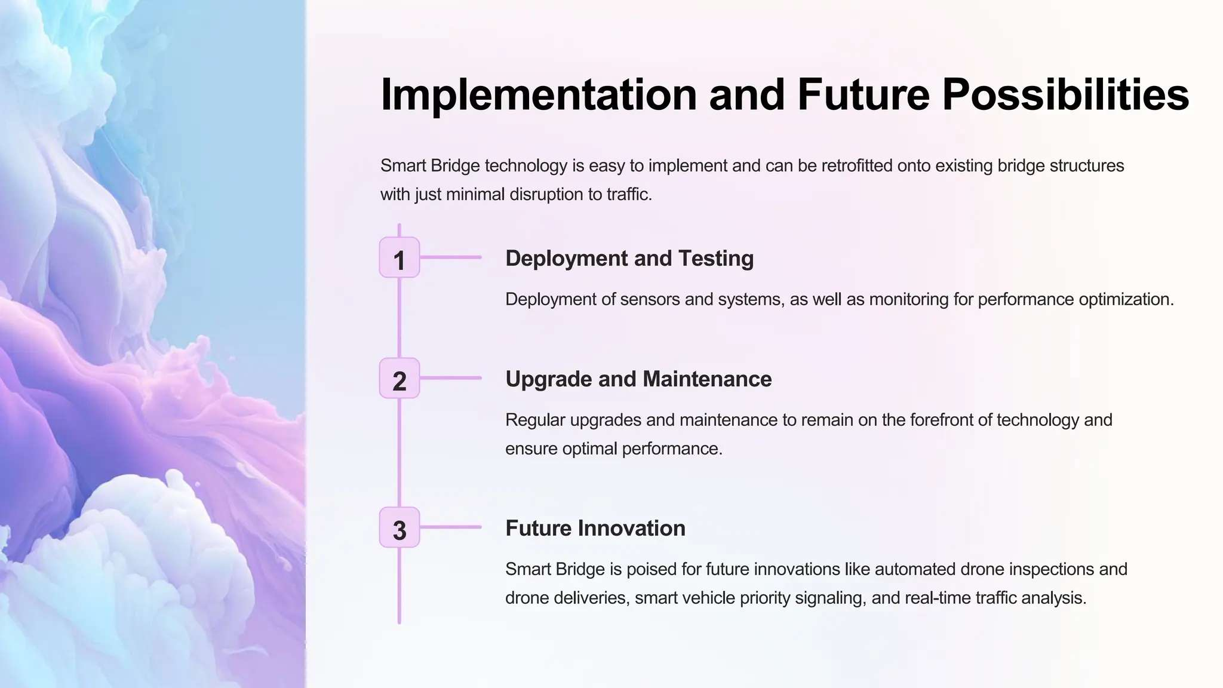

Slide 13
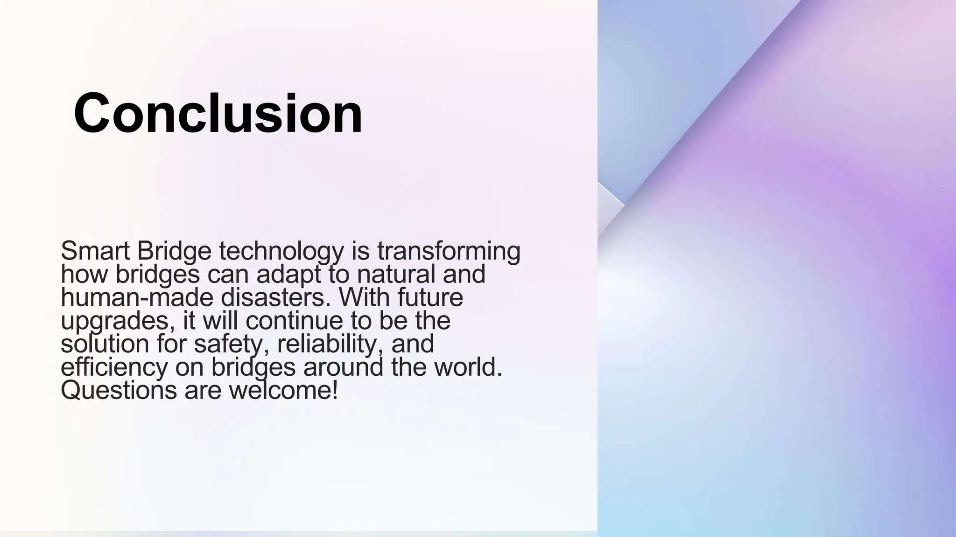

Slide 14

THANK YOU

